Slide 1
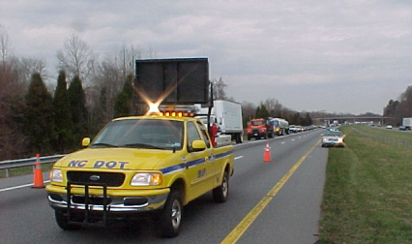
Lesson 2:
TIM Fundamentals and Terminology
Notes:
0

Slide 2
Lesson Objectives
Lesson 2
At the conclusion of this lesson, participants will be able to:
Define safe, quick clearance
List the principal laws that relate to responder safety and safe, quick clearance
Describe how the Manual on Uniform Traffic Control Devices (MUTCD) relates to TIM
Recall common response terminology, lane designations, and incident scene terminology

Slide 3
Safe, Quick Clearance
Lesson 2
Safe, Quick Clearance…
Second of the three main NUG objectives, it is the practice of rapidly, safely, and aggressively removing temporary obstructions from the roadway
Disabled vehicles
Wrecked vehicles
Debris
Spilled cargo
Notes:
Safe, quick clearance is the practice of rapidly, safely, and aggressively removing temporary obstructions from the roadway to:
Increase the safety of incident responders by minimizing their exposure to adjacent passing traffic
Reduce the probability of secondary crashes
Relieve overall congestion and delay
Quick, clearance goals
Restore the roadway to its pre-incident capacity as quickly and safely as possible
Minimize motorists delays though traffic control and opening of lanes
Make effective use of all clearance resources
Enhance the safety of responders and motorists
Protect the roadway system and private property from unnecessary damage during the removal process
Safe, quick clearance and responder safety are NOT mutually exclusive, as a matter of fact they complement each other

Slide 4
What is Safe, Quick Clearance?
Lesson 2
Working with a sense of urgency
Utilizing Unified Command and incorporating safe, quick clearance into the incident objectives
Completing tasks concurrently whenever possible
Regularly assessing traffic control and on-scene activities to determine if additional lanes can be opened
Utilizing all available resources for clearance activities
Thinking outside of the box and considering how things could be done differently
Notes:
Paraphrase slide content

Slide 5
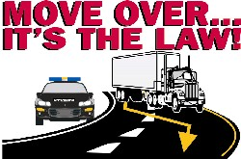
Move Over Laws
Lesson 2
Move Over Law NCGS-20-157(f) -- 2002
This law applies to a public service vehicle which is parked as a result of an emergency response and giving appropriate warning signals. The approaching traffic shall merge into the opposite lane if that lane is clear, and the movement can be made in safety as long as there is more than one lane proceeding in the same direction.
Includes punishments:
  Violation without damage or injury – Fine $250 and Cost of Court
  Violation with damage over $500 or injury to officer etc., Class 1 misdemeanor
  Violation with serious injury or death – Class I Felony
Notes:
As of 2012, every state has a Move Over Law – below is North Carolina’s Move Over Law (GS-20-157f);
20-157. Approach of law enforcement, fire department or rescue squad vehicles or ambulances; driving over fire hose or blocking fire-fighting equipment; parking, etc., near law enforcement, fire department, or rescue squad vehicle or ambulance.
(a) Upon the approach of any law enforcement or fire department vehicle or public or private ambulance or rescue squad emergency service vehicle, or a vehicle operated by the Division of Marine Fisheries, or the Division of Parks and Recreation of the Department of Environment and Natural Resources, or the North Carolina Forest Service of the Department of Agriculture and Consumer Services when traveling in response to a fire alarm or other emergency response purpose, giving warning signal by appropriate light and by audible bell, siren or exhaust whistle, audible under normal conditions from a distance not less than 1000 feet, the driver of every other vehicle shall immediately drive the same to a position as near as possible and parallel to the right-hand edge or curb, clear of any intersection of streets or highways, and shall stop and remain in such position unless otherwise directed by a law enforcement or traffic officer until the law enforcement or fire department vehicle, or the vehicle operated by the Division of Marine Fisheries, or the Division of Parks and Recreation of the Department of Environment and Natural Resources, or the North Carolina Forest Service of the Department of Agriculture and Consumer Services, or the public or private ambulance or rescue squad emergency service vehicle shall have passed. Provided, however, this subsection shall not apply to vehicles traveling in the opposite direction of the vehicles herein enumerated when traveling on a four-lane limited access highway with a median divider dividing the highway for vehicles traveling in opposite directions, and provided further that the violation of this subsection shall be negligence per se. Violation of this subsection is a Class 2 misdemeanor.
(b) It shall be unlawful for the driver of any vehicle other than one on official business to follow any fire apparatus traveling in response to a fire alarm closer than one block or to drive into or park such vehicle within one block where fire apparatus has stopped in answer to a fire alarm.
(c) Outside of the corporate limits of any city or town it shall be unlawful for the driver of any vehicle other than one on official business to follow any fire apparatus traveling in response to a fire alarm closer than 400 feet or to drive into or park such vehicle within a space of 400 feet from where fire apparatus has stopped in answer to a fire alarm.
(d) It shall be unlawful to drive a motor vehicle over a fire hose or any other equipment that is being used at a fire at any time, or to block a fire-fighting apparatus or any other equipment from its source of supply regardless of its distance from the fire.
(e) It shall be unlawful for the driver of a vehicle, other than one on official business, to park and leave standing such vehicle within 100 feet of law enforcement or fire department vehicles, public or private ambulances, or rescue squad emergency vehicles which are engaged in the investigation of an accident or engaged in rendering assistance to victims of such accident.
(f) When an authorized emergency vehicle as described in subsection (a) of this section or any public service vehicle is parked or standing within 12 feet of a roadway and is giving a warning signal by appropriate light, the driver of every other approaching vehicle shall, as soon as it is safe and when not otherwise directed by an individual lawfully directing traffic, do one of the following:
(1) Move the vehicle into a lane that is not the lane nearest the parked or standing authorized emergency vehicle or public service vehicle and continue traveling in that lane until safely clear of the authorized emergency vehicle. This paragraph applies only if the roadway has at least two lanes for traffic proceeding in the direction of the approaching vehicle and if the approaching vehicle may change lanes safely and without interfering with any vehicular traffic.
(2) Slow the vehicle, maintaining a safe speed for traffic conditions, and operate the vehicle at a reduced speed and be prepared to stop until completely past the authorized emergency vehicle or public service vehicle. This paragraph applies only if the roadway has only one lane for traffic proceeding in the direction of the approaching vehicle or if the approaching vehicle may not change lanes safely and without interfering with any vehicular traffic.
For purposes of this section, "public service vehicle" means a vehicle that is being used to assist motorists or law enforcement officers with wrecked or disabled vehicles, or is a vehicle being used to install, maintain, or restore utility service, including electric, cable, telephone, communications, and gas, or is a highway maintenance vehicle owned and operated by or contracted by the State or a local government, and is operating an amber-colored flashing light authorized by G.S. 20-130.2. Violation of this subsection shall be negligence per se.
(g) Except as provided in subsections (a), (h), and (i) of this section, violation of this section shall be an infraction punishable by a fine of two hundred fifty dollars ($250.00).
(h) A person who violates this section and causes damage to property in the immediate area of the authorized emergency vehicle or public service vehicle in excess of five hundred dollars ($500.00), or causes injury to a law enforcement officer, a firefighter, an emergency vehicle operator, an Incident Management Assistance Patrol member, a public service vehicle operator, or any other emergency response person in the immediate area of the authorized emergency vehicle or public service vehicle is guilty of a Class 1 misdemeanor.
(i) A person who violates this section and causes serious injury or death to a law enforcement officer, a firefighter, an emergency vehicle operator, an Incident Management Assistance Patrol member, a public service vehicle operator, or any other emergency response person in the immediate area of the authorized emergency vehicle or public service vehicle is guilty of a Class I felony. The Division may suspend, for up to six months, the drivers license of any person convicted under this subsection. If the Division suspends a person's license under this subsection, a judge may allow the licensee a limited driving privilege for a period not to exceed the period of suspension, provided the person's license has not also been revoked or suspended under any other provision of law. The limited driving privilege shall be issued in the same manner and under the terms and conditions prescribed in G.S. 20-16.1(b). (1937, c. 407, s. 119; 1955, cc. 173, 744; 1971, c. 366, ss. 1, 2; 1985, c. 764, s. 31; 1985 (Reg. Sess., 1986), c. 852, s. 17; 1993, c. 539, s. 372; 1994, Ex. Sess., c. 24, s. 14(c); 2001-331, s. 1; 2005-189, s. 1; 2006-259, s. 9; 2007-360, s. 1; 2010-132, s. 12; 2012-14, s. 1; 2013-415, s. 1(e).)

Slide 6
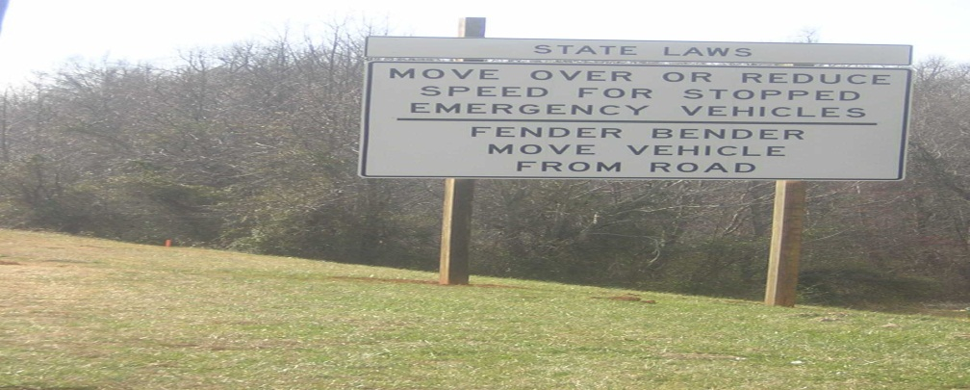
Driver Removal Laws
Lesson 2
Fender Bender NCGS-20-166(c2) --2003
The law requires that drivers involved in a minor collision shall move their vehicles to shoulder of the roadway or a safe location as soon as possible, as long as the crash did not result in death, injury, and the vehicle can be safely driven.
Law was developed to reduce secondary collisions
Violation can amount to a Fine $25.00 and Cost of Court.
Notes:
§ 20-166. Duty to stop in event of a crash; furnishing information or assistance to injured person, etc.; persons assisting exempt from civil liability.
(a) The driver of any vehicle who knows or reasonably should know:
(1) That the vehicle which he or she is operating is involved in a crash; and
(2) That the crash has resulted in serious bodily injury, as defined in G.S. 14-32.4, or death to any person;
shall immediately stop his or her vehicle at the scene of the crash. The driver shall remain with the vehicle at the scene of the crash until a law-enforcement officer completes the investigation of the crash or authorizes the driver to leave and the vehicle to be removed, unless remaining at the scene places the driver or others at significant risk of injury.
Prior to the completion of the investigation of the crash by a law enforcement officer, or the consent of the officer to leave, the driver may not facilitate, allow, or agree to the removal of the vehicle from the scene for any purpose other than to call for a law enforcement officer, to call for medical assistance or medical treatment as set forth in subsection (b) of this section, or to remove oneself or others from significant risk of injury. If the driver does leave for a reason permitted by this subsection, then the driver must return with the vehicle to the accident scene within a reasonable period of time, unless otherwise instructed by a law enforcement officer. A willful violation of this subsection shall be punished as a Class F felony.
(a1) The driver of any vehicle who knows or reasonably should know:
(1) That the vehicle which he or she is operating is involved in a crash; and
(2) That the crash has resulted in injury;
shall immediately stop his or her vehicle at the scene of the crash. The driver shall remain with the vehicle at the scene of the crash until a law enforcement officer completes the investigation of the crash or authorizes the driver to leave and the vehicle to be removed, unless remaining at the scene places the driver or others at significant risk of injury.
Prior to the completion of the investigation of the crash by a law enforcement officer, or the consent of the officer to leave, the driver may not facilitate, allow, or agree to the removal of the vehicle from the scene for any purpose other than to call for a law enforcement officer, to call for medical assistance or medical treatment as set forth in subsection (b) of this section, or to remove oneself or others from significant risk of injury. If the driver does leave for a reason permitted by this subsection, then the driver must return with the vehicle to the crash scene within a reasonable period of time, unless otherwise instructed by a law enforcement officer. A willful violation of this subsection shall be punished as a Class H felony.
(b) In addition to complying with the requirements of subsections (a) and (a1) of this section, the driver as set forth in subsections (a) and (a1) shall give his or her name, address, driver's license number and the license plate number of the vehicle to the person struck or the driver or occupants of any vehicle collided with, provided that the person or persons are physically and mentally capable of receiving such information, and shall render to any person injured in such crash reasonable assistance, including the calling for medical assistance if it is apparent that such assistance is necessary or is requested by the injured person. A violation of this subsection is a Class 1 misdemeanor.
(c) The driver of any vehicle, when the driver knows or reasonably should know that the vehicle which the driver is operating is involved in a crash which results:
(1) Only in damage to property; or
(2) In injury or death to any person, but only if the operator of the vehicle did not know and did not have reason to know of the death or injury;
shall immediately stop the vehicle at the scene of the crash. If the crash is a reportable crash, the driver shall remain with the vehicle at the scene of the crash until a law enforcement officer completes the investigation of the crash or authorizes the driver to leave and the vehicle to be removed, unless remaining at the scene places the driver or others at significant risk of injury.
Prior to the completion of the investigation of the crash by a law enforcement officer, or the consent of the officer to leave, the driver may not facilitate, allow, or agree to the removal of the vehicle from the scene, for any purpose other than to call for a law enforcement officer, to call for medical assistance or medical treatment, or to remove oneself or others from significant risk of injury. If the driver does leave for a reason permitted by this subsection, then the driver must return with the vehicle to the accident scene within a reasonable period of time, unless otherwise instructed by a law enforcement officer. A willful violation of this subsection is a Class 1 misdemeanor.
(c1) In addition to complying with the requirement of subsection (c) of this section, the driver as set forth in subsection (c) shall give his or her name, address, driver's license number and the license plate number of his vehicle to the driver or occupants of any other vehicle involved in the crash or to any person whose property is damaged in the crash. If the damaged property is a parked and unattended vehicle and the name and location of the owner is not known to or readily ascertainable by the driver of the responsible vehicle, the driver shall furnish the information required by this subsection to the nearest available peace officer, or, in the alternative, and provided the driver thereafter within 48 hours fully complies with G.S. 20-166.1(c), shall immediately place a paper-writing containing the information in a conspicuous place upon or in the damaged vehicle. If the damaged property is a guardrail, utility pole, or other fixed object owned by the Department of Transportation, a public utility, or other public service corporation to which report cannot readily be made at the scene, it shall be sufficient if the responsible driver shall furnish the information required to the nearest peace officer or make written report thereof containing the information by U.S. certified mail, return receipt requested, to the North Carolina Division of Motor Vehicles within five days following the collision. A violation of this subsection is a Class 1 misdemeanor.
(c2) Notwithstanding subsections (a), (a1), and (c) of this section, if a crash occurs on a main lane, ramp, shoulder, median, or adjacent area of a highway, each vehicle shall be moved as soon as possible out of the travel lane and onto the shoulder or to a designated accident investigation site to complete the requirements of this section and minimize interference with traffic if all of the following apply:
(1) The crash has not resulted in injury or death to any person or the drivers did not know or have reason to know of any injury or death.
(2) Each vehicle can be normally and safely driven. For purposes of this subsection, a vehicle can be normally and safely driven if it does not require towing and can be operated under its own power and in its usual manner, without additional damage or hazard to the vehicle, other traffic, or the roadway.
(d) Any person who renders first aid or emergency assistance at the scene of a motor vehicle crash on any street or highway to any person injured as a result of the accident, shall not be liable in civil damages for any acts or omissions relating to the services rendered, unless the acts or omissions amount to wanton conduct or intentional wrongdoing.
(e) The Division of Motor Vehicles shall revoke the drivers license of a person convicted of violating subsection (a) or (a1) of this section for a period of one year, unless the court makes a finding that a longer period of revocation is appropriate under the circumstances of the case. If the court makes this finding, the Division of Motor Vehicles shall revoke that person's drivers license for two years. Upon a first conviction only for a violation of subsection (a1) of this section, a trial judge may allow limited driving privileges in the manner set forth in G.S. 20-179.3(b)(2) during any period of time during which the drivers license is revoked. (1937, c. 407, s. 128; 1939, c. 10, ss. 1, 11/2; 1943, c. 439; 1951, cc. 309, 794, 823; 1953, cc. 394, 793; c. 1340, s. 1; 1955, c. 913, s. 8; 1965, c. 176; 1967, c. 445; 1971, c. 958, s. 1; 1973, c. 507, s. 5; 1975, c. 716, s. 5; 1977, c. 464, s. 34; 1979, c. 667, s. 32; 1983, c. 912, s. 1; 1985, c. 324, ss. 1-4; 1993, c. 539, ss. 373-375, 1260; 1994, Ex. Sess., c. 24, s. 14(c); 2003-310, s. 2; 2003-394, s. 1; 2005-460, s. 1; 2008-128, s. 1.)

Slide 7
Authority Removal Laws
Lesson 2
Removal of Vehicles 20-161 (f)
The law allows any investigating law enforcement officer, with concurrence of NCDOT, to immediately remove a vehicle from the roadway that is interfering with regular flow of traffic or which constitutes a hazard.
Note: DO NOT remove a vehicle involving personal injury or death as a result of a collision until the investigative agency advises the removal.
Any agency carrying out this section cannot be held criminally or civilly liable for any damages or injuries as a result of the removal or disposition of the vehicle, cargo or personal property.
Notes:
§ 20-161. Stopping on highway prohibited; warning signals; removal of vehicles from public highway.
(a) No person shall park or leave standing any vehicle, whether attended or unattended, upon the main-traveled portion of any highway or highway bridge with the speed limit posted less than 45 miles per hour unless the vehicle is disabled to such an extent that it is impossible to avoid stopping and temporarily leaving the vehicle upon the paved or main traveled portion of the highway or highway bridge. This subsection shall not apply to a solid waste vehicle stopped on a highway while engaged in collecting garbage as defined in G.S. 20-118(c)(5)g. or recyclable material as defined in G.S. 130A-290(a)(26).
(a1) No person shall park or leave standing any vehicle, whether attended or unattended, upon the paved or main-traveled portion of any highway or highway bridge with the speed limit posted 45 miles per hour or greater unless the vehicle is disabled to such an extent that it is impossible to avoid stopping and temporarily leaving the vehicle upon the paved or main-traveled portion of the highway or highway bridge. This subsection shall not apply to a solid waste vehicle stopped on a highway while engaged in collecting garbage as defined in G.S. 20-118(c)(5)g. or recyclable material as defined in G.S. 130A-290(a)(26).
(b) No person shall park or leave standing any vehicle upon the shoulder of a public highway unless the vehicle can be clearly seen by approaching drivers from a distance of 200 feet in both directions and does not obstruct the normal movement of traffic.
(c) The operator of any truck, truck tractor, trailer or semitrailer which is disabled upon any portion of the highway shall display warning devices of a type and in a manner as required under the rules and regulations of the United States Department of Transportation as adopted by the Division of Motor Vehicles. Such warning devices shall be displayed as long as the vehicle is disabled.
(d) The owner of any vehicle parked or left standing in violation of law shall be deemed to have appointed any investigating law-enforcement officer his agent:
(1) For the purpose of removing the vehicle to the shoulder of the highway or to some other suitable place; and
(2) For the purpose of arranging for the transportation and safe storage of any vehicle which is interfering with the regular flow of traffic or which otherwise constitutes a hazard, in which case the officer shall be deemed a legal possessor of the vehicle within the meaning of G.S. 44A-2(d).
(e) When any vehicle is parked or left standing upon the right-of-way of a public highway, including rest areas, for a period of 24 hours or more, the owner shall be deemed to have appointed any investigating law-enforcement officer his agent for the purpose of arranging for the transportation and safe storage of such vehicle and such investigating law-enforcement officer shall be deemed a legal possessor of the motor vehicle within the meaning of that term as it appears in G.S. 44A-2(d).
(f) Any investigating law enforcement officer, with the concurrence of the Department of Transportation, may immediately remove or cause to be removed from the State highway system any wrecked, abandoned, disabled, unattended, burned, or partially dismantled vehicle, cargo, or other personal property interfering with the regular flow of traffic or which otherwise constitutes a hazard. In the event of a motor vehicle crash involving serious personal injury or death, no removal shall occur until the investigating law enforcement officer determines that adequate information has been obtained for preparation of a crash report. No state or local law enforcement officer, Department of Transportation employee, or person or firm contracting or assisting in the removal or disposition of any such vehicle, cargo, or other personal property shall be held criminally or civilly liable for any damage or economic injury related to carrying out or enforcing the provisions of this section.
(g) The owner shall be liable for any costs incurred in the removal, storage, and subsequent disposition of a vehicle, cargo, or other personal property under the authority of this section. (1937, c. 407, s. 123; 1951, c. 1165, s. 1; 1971, c. 294, s. 1; 1973, c. 1330, s. 25; 1985, c. 454, s. 6; 2003-310, s. 1; 2007-360, ss. 4, 5; 2009-104, s. 1; 2010-132, ss. 13, 14, 15.)

Slide 8
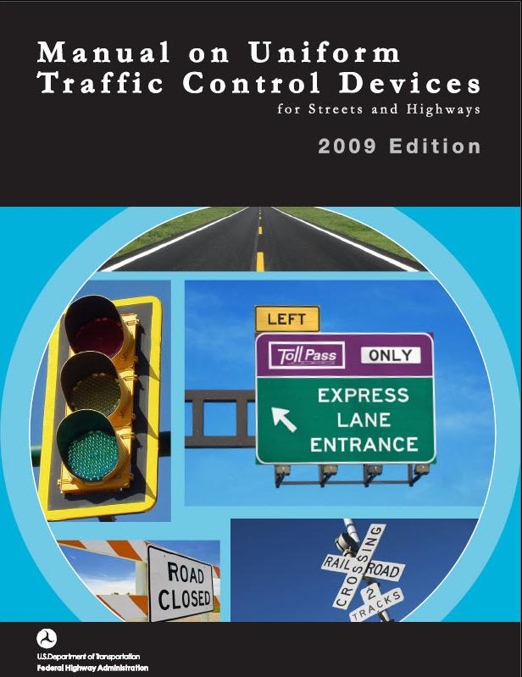
Manual on Uniform Traffic Control Devices (MUTCD)
Lesson 2
Federal guideline for all traffic control nationwide
It also covers all “workers” on all streets, roadways, or highways
This course addresses what is required to adhere to MUTCD standards
Notes:
The Manual on Uniform Traffic Control Devices is commonly referred to as the MUTCD
The MUTCD is a national standard that was first published in 1935, and it has been maintained by FHWA since 1971
The current version was published in 2009, and the PDF is 864 pages
The manual promotes uniformity of traffic control devices like signs, signals, and markings, which improves safety and driver expectancy
There was extensive participation by practitioners in developing and evaluating the content of the MUTCD, including transportation and public safety
States may adopt the document as is, add a state supplement, or create a state version, but the content remains mostly uniform

Slide 9
MUTCD Chapter 6I
Lesson 2
Control of Traffic through Traffic Incident Management Areas
Includes the following 5 Sections:
  6I.01 – General (Information)
  6I.02 – Major Traffic Incidents
  6I.03 – Intermediate Traffic Incidents
  6I.04 – Minor Traffic Incidents
  6I.05 – Use of Emergency-Vehicle Lighting
Notes:
Part 6 of the MUTCD covers Temporary Traffic Control (TTC) zones, commonly known as highway construction or work zones
A subset of Part 6 is Chapter 6I (pronounced “six-eye”), which specifically addresses traffic incidents
Because they are emergency events of a temporary nature, traffic incidents are different from highway work zones and are not required to conform with the requirements of work zones
Review the five sections of Chapter 6I

Slide 10









Traffic Incident Management Area
Lesson 2
Temporary Traffic Control (TTC) should be deployed based on conditions, road geometrics, and available TTC devices
Advance Warning Area
Transition Area
Activity Area Buffer Space + Incident Space
Termination Area
L
1
2
R
Initial TTC – Minimal measures deployed immediately using limited TTC devices (i.e. what’s on-hand)
Emergency TTC – Additional measures deployed as soon as possible using basic TTC devices (e.g. Arrow Board, longer tapers & buffers, etc.)
Parking Order – General positioning of responder vehicles in the Activity Area
MUTCD-Compliant TTC – Complete measures deployed for longer-term incidents using a range of TTC devices (e.g. Advance warning signs, lateral buffers, etc.)
Pink Advance Warning Sign
Notes:
Animation: Click forward to make the Buffer and Incident Space labels appear
A Traffic Incident Management Area is a type of TTC zone
A Traffic Incident Management Area has four main components:
Advance Warning Area
Transition Area
Activity Area
Termination Area
The Activity Area is further comprised of a Buffer Space and an Incident Space
The parts of a Traffic Incident Management Area are covered in greater detail in Lesson 7
Note the general positioning of the responder vehicles, this will be covered more in Lesson 4
The main graphic of this slide shows an ideal temporary traffic control (TTC) setup using additional TTC resources provided by IMAP/NCDOT Maintenance
All traffic incidents and scenes are different – responders must determine what their traffic control needs & resources are and deploy appropriate TTC accordingly
IMAP may NOT be available in certain areas or at certain times – responders can still receive assistance with traffic control by calling NCDOT
NCDOT Maintenance vehicles may utilize truck-mounted and/or trailer-mounted Changeable Message Signs (CMS) or Arrow Boards

Slide 11
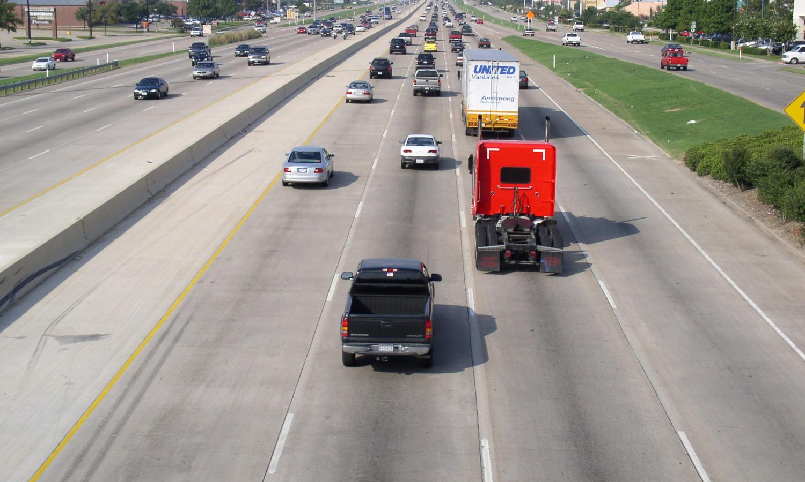
Lane Designation Terminology
– Plain English
Lesson 2
Right Shoulder
(Outside)
Left Shoulder
(Inside)
Left Lane
Right Lane
Left
Center Lane
Right Center Lane
Notes:
The National Incident Management System (NIMS) requires the use of the Incident Command System (ICS) at traffic incident scenes
ICS requires the use of uniform terminology and plain English
Incident communications should be easily understood by all responders and responder disciplines
Review recommended response terminology for elements of this eight-lane divided highway
Left and right are determined from the perspective of the flow of traffic
Left is often analogous with inside and right with outside
Transition: For highways with four or more lanes, the plain English process for identifying lanes can become confusing, which is why lane numbering may be used for lane identification

Slide 12
Lane Designation Terminology
– Recommended Lane Numbering
Lesson 2
Lane 1
Lane 4
Lane 2
Lane 3
Notes:
A system for numbering lanes is an alternative to the lane names like left, right, etc.
The recommended practice for describing travel lanes involves use of a left-to-right lane numbering system, from the perspective of the flow of traffic
Either plain English or numbering are acceptable, provided area responders train to both

Slide 13
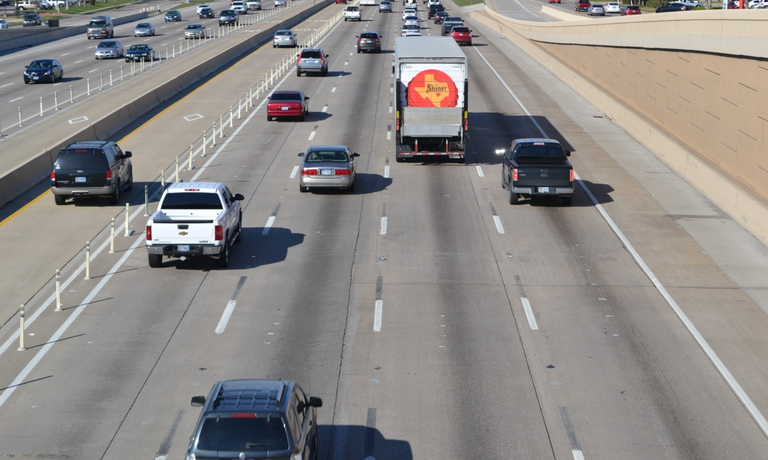
Lane Designation Terminology
– Recommended Lane Numbering
Lesson 2
HOV Lane
Lane 1
Lane 2
Lane 3
Lane 4
Notes:
Note that a special or unique use lane, such as an high-occupancy vehicle (HOV) lane, is not a numbered lane
The HOV lane shown here should just be referred to as the “HOV Lane”
“Lane 1” would be the first general traffic lane

Slide 14
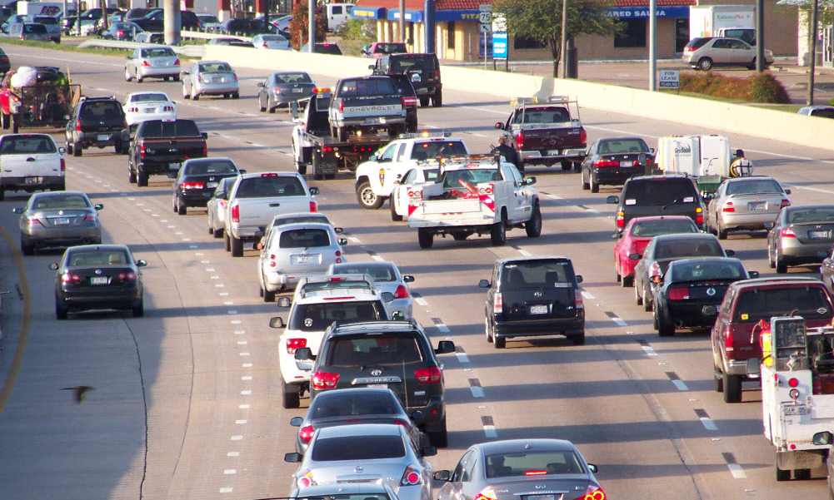
Upstream and Downstream
Lesson 2
Departing traffic is:
Downstream
If incident is here…
Approaching traffic is:
Upstream
Notes:
Traffic that is departing or past the incident is considered downstream traffic
Traffic that is entering or approaching the incident scene is considered upstream traffic
Relate these terms as being similar to how running water flows past a fixed point - upstream and downstream

Slide 15
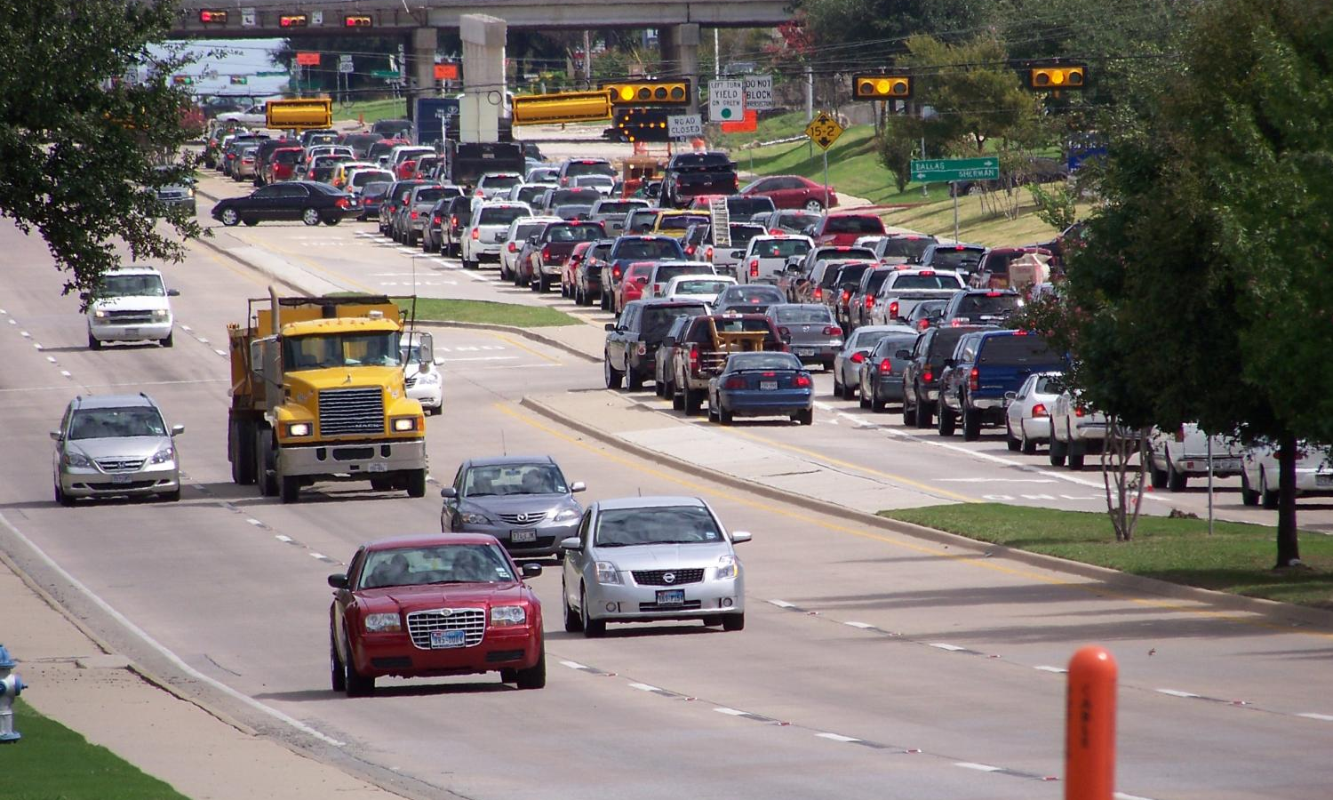
Traffic Queues
– Backup of Approaching Traffic
Lesson 2
Notes:
A traffic queue is the backup of traffic that results from an incident or blocked lanes
It is pronounced “Q”
A queue may form in either direction of travel because of rubberneckers
The back of a queue is a very dangerous place, as we saw in the earlier slide where the tractor trailers were involved in a fatal crash four miles from the original incident
Responders must mind the back of queues, which will be discussed in further detail in Lesson 7

Slide 16
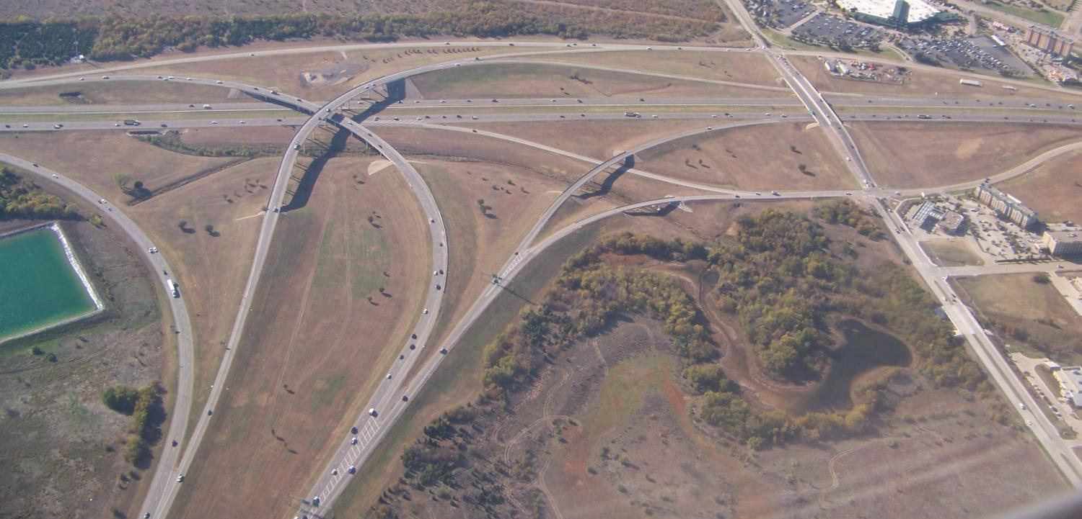
Common Response Terminology
Lesson 2
On-ramp/Off-ramp
Service Road/Access Road
Distributor/Collector Road
Overpass/Underpass
Notes:
Review the common response terminology used to describe a variety of roadway and highway features that may exist within the local region
On-ramp/off-ramp
Distributor/collector road
Service road
Access road
Overpass/underpass
Flyover
Median turnaround

Slide 17
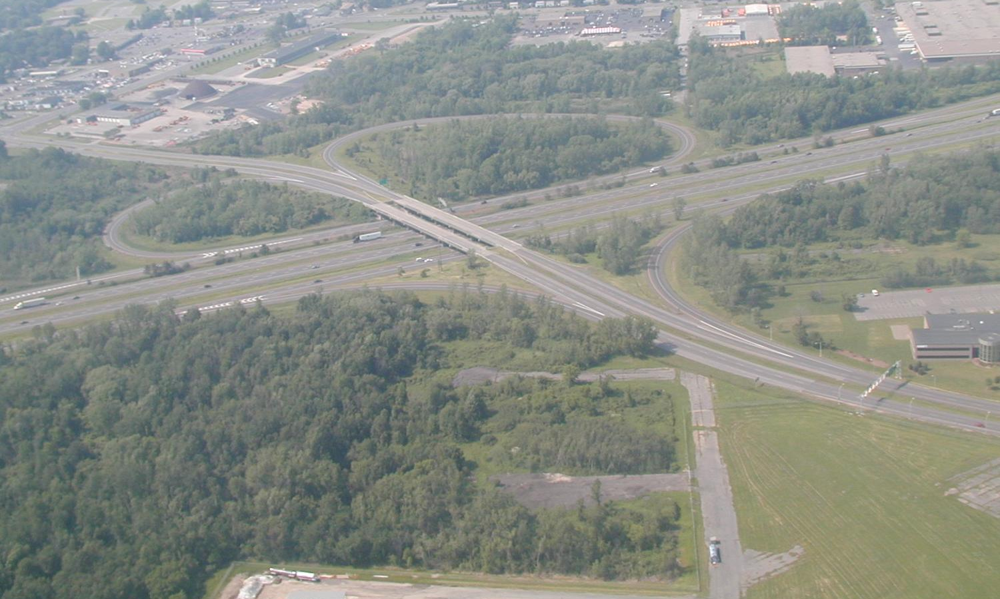
Student Activity 
Lesson 2
Incident Location
East
North
Highway Y
West
Highway X
South
Notes:
For this student activity, select one class participant
Explain that they are on this scene as the first-arriving responder
Ask them to describe the location of the incident as if they were radioing their location to their communications center
Answer: The incident is on the Highway X northbound ramp to Highway Y westbound

Slide 18
Student Activity 
Lesson 2
East
North
Highway Y
Incident Location
West
Highway X
South
Notes:
Using the same highway scene, select a different class participant
Explain that they are on this scene as the first-arriving responder
Ask them to describe the location of the incident as if they were radioing their location to their communications center
Answer: The incident is on the westbound frontage or collector road just prior to the Highway X southbound on-ramp

Slide 19
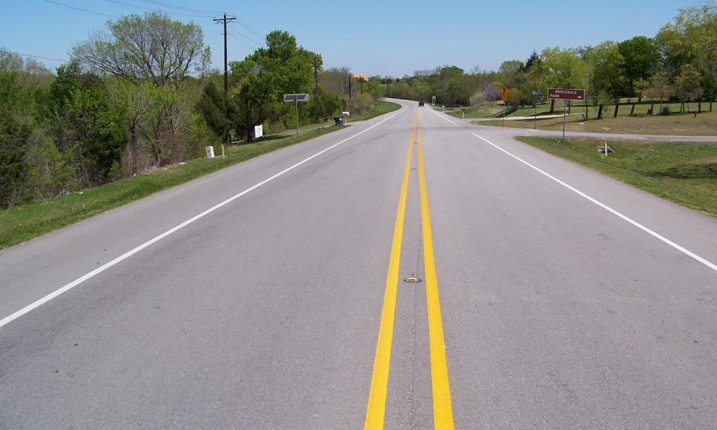
Rural Road Response Terminology
Lesson 2
Westbound Shoulder
Eastbound Shoulder
Westbound Lane
Eastbound Lane
Notes:
Emphasize that TIM does not just apply to urban freeway environments
Rural road response terminology is very similar to what has already been discussed
Stress that directions are according to the posted road signs and not compass readings

Slide 20
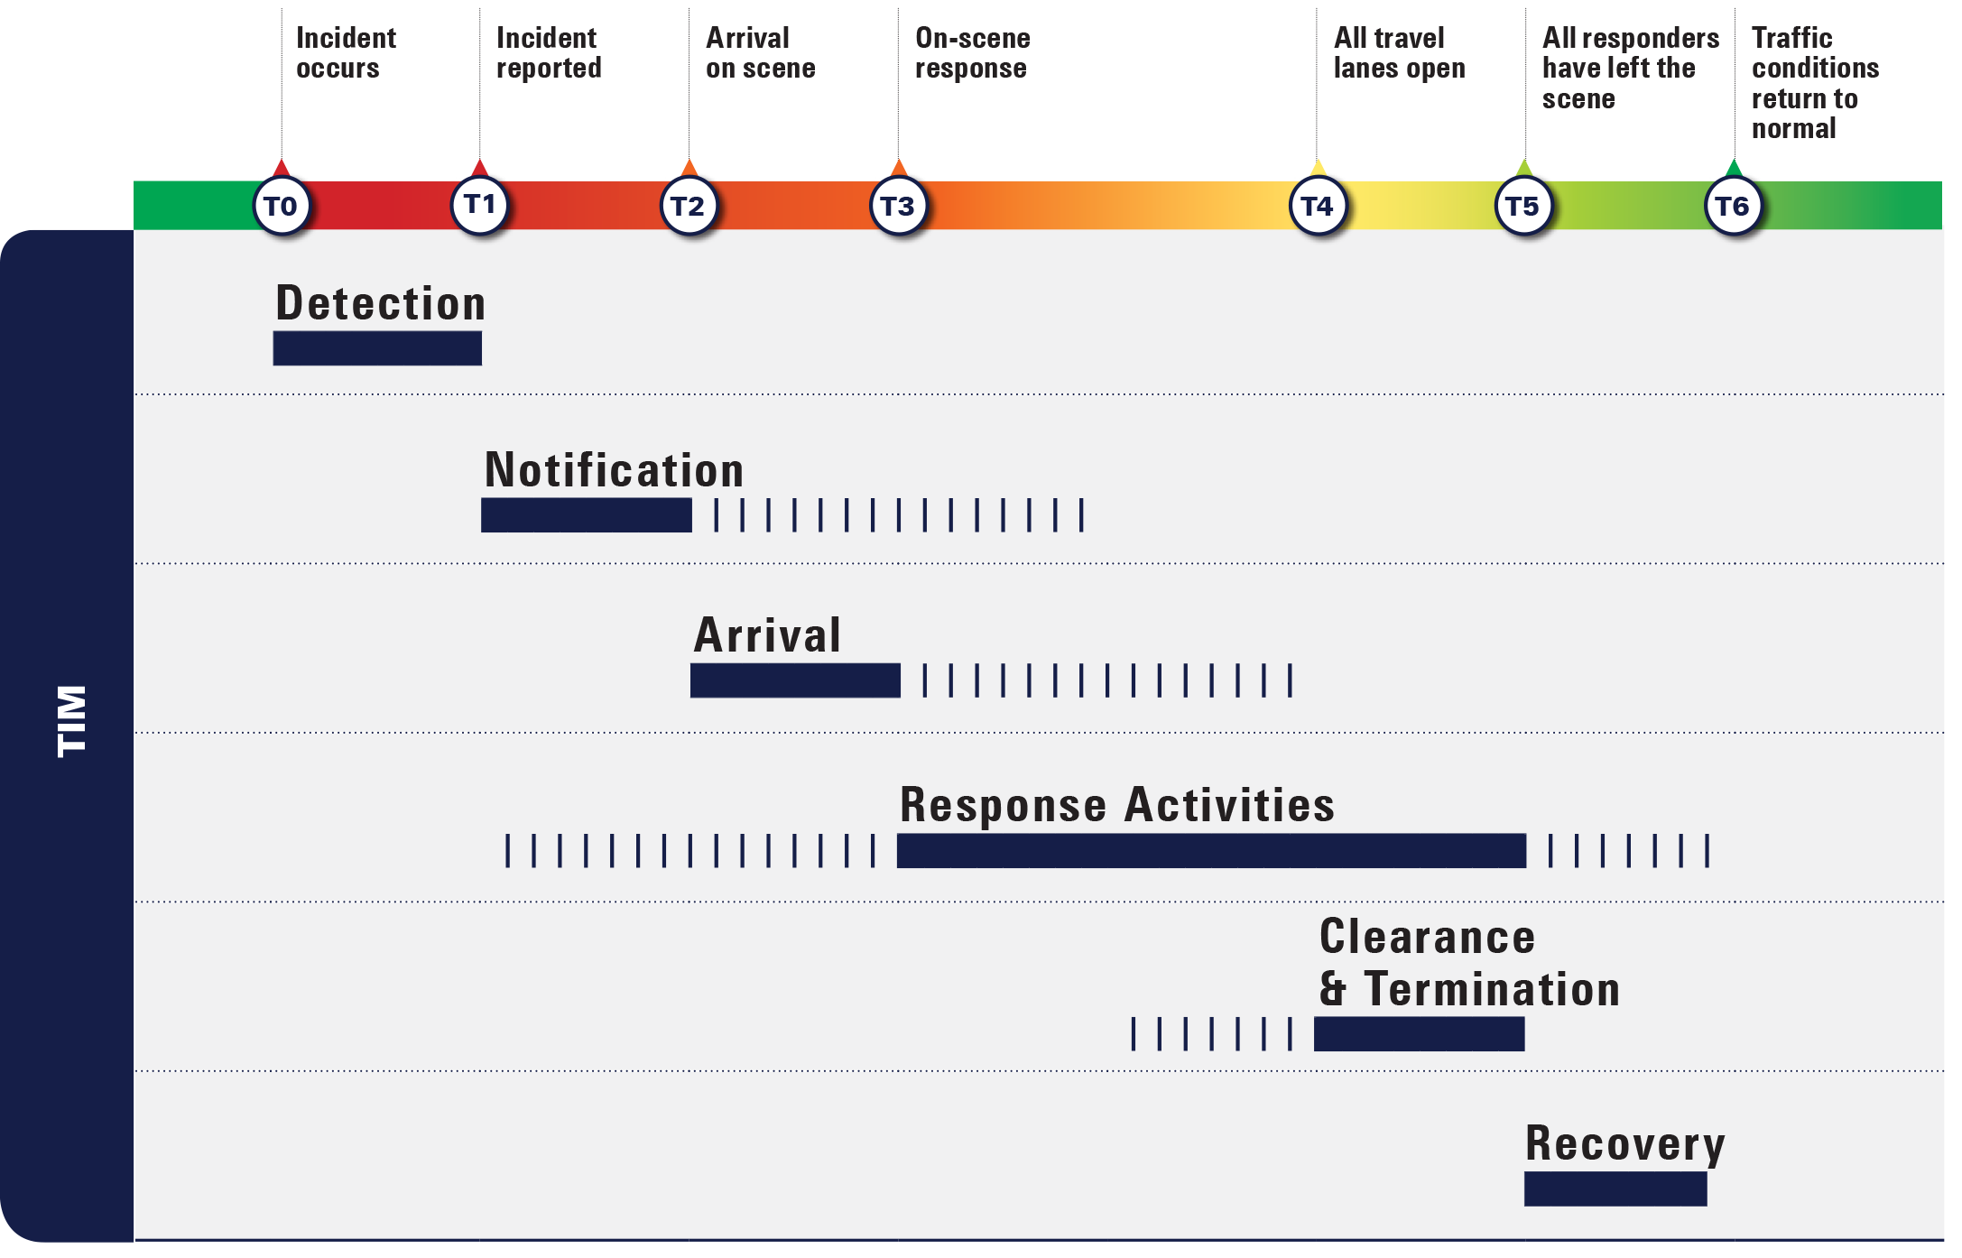
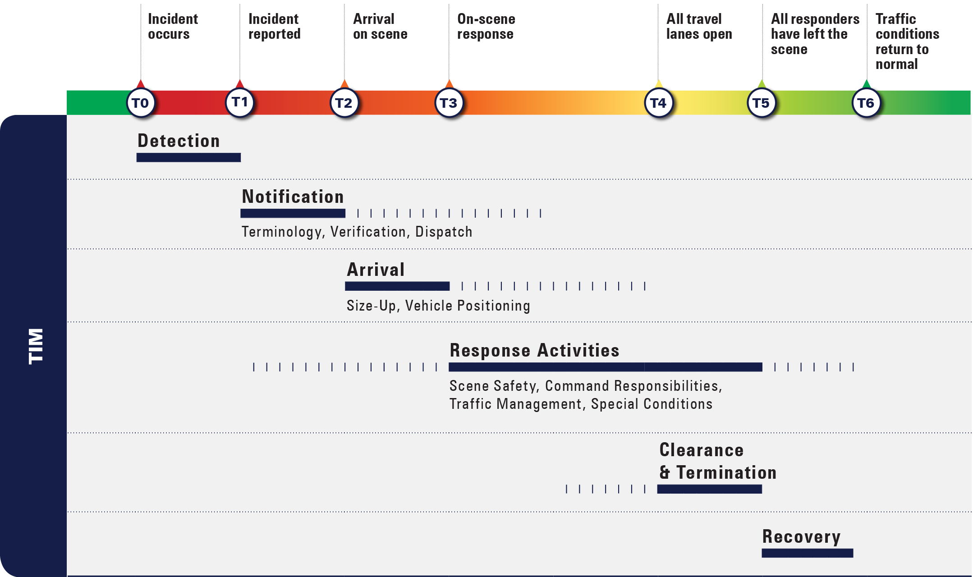
TIM Timeline
Lesson 2
Notes:
Animation: Click forward to make dark orange box appear and then click again to bring up detailed view of Notification
Ask/Discuss: How does the use of common terminology impact the TIM Timeline?
Accurate, clear communication among all disciplines involved in TIM means responders arrive at the scene quickly, clear the scene sooner, and improve safety for themselves and those involved in incidents

Slide 21
Lesson 3:
Notification and
Scene Size-Up
Copyright © 2009 K2Share LLC.

Slide 22
Lesson Objectives
Lesson 3
At the conclusion of this lesson, participants will be able to:
Recognize the important role public safety communications centers play in incident response
Describe the notification and verification process
Recall the typical responsibilities of a Transportation Management Center (TMC)
List the key information that should be included in a scene size-up report

Slide 23
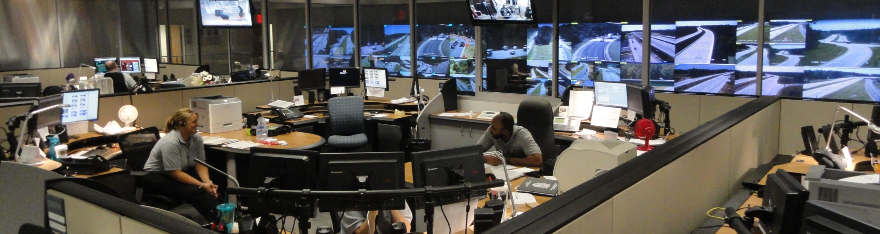
Public Safety
Communications Centers
Lesson 3
Telecommunicators are often the first to receive notification of an incident and are responsible for:
  Providing a basic assessment of the situation
  Dispatching an appropriate response based on their knowledge of available resources
Notes:
The first step of the TIM process is detection, a term used to refer to the discovery of an incident
Incident detection can be a call from the parties involved in the incident or a call from a passing motorist
Incidents may also be detected by responders who happen upon them
Telecommunicators working at public safety communications centers are typically the first to receive notification of an incident
TIM training is very beneficial to telecommunicators, given their important role
Understanding TIM concepts and terminology ensures telecommunicators are able to aid responders
Knowing available TIM resources and assets is part of a telecommunicator’s basic duties
The nature of their job requires telecommunicators to be proficient at multi-tasking, using computers, radios, and telephones
They are the conduit or connection between individuals, agencies, and other resources
The accuracy, timeliness, and overall quality of information received by dispatch has a significant impact on effective TIM

Slide 24
Verification
Lesson 3
Verification involves collecting sufficient information on the nature of the incident including identifying:
  Type and level of incident
  Exact physical location
  Number of vehicles involved
    Color and type if possible
  Lanes affected
  Injuries, entrapment
Notes:
Verification involves collecting as much information as possible from the individual(s) reporting the incident
Be aware that other agencies, such as DOT, rely on the information that is gathered to plan how they will respond
Agencies that are NOT involved in law enforcement or emergency medical services typically DO NOT need to know sensitive information (e.g. names of people involved, types of injuries, etc.)
However, they will need a clear picture of the incident – what’s happening, where it is, what’s involved, what’s affected, etc.
If you don’t have the information requested, THAT’S OKAY – when possible, try to find the information and follow back up with the requesting agency
Interagency cooperation is a MUST – all partners should work together and trust one another to provide the info they can & use the info appropriately
Emphasize that the make, model, and color of the involved vehicles can assist responders in locating the incident
Vehicle descriptions can also clarify potential duplicate calls

Slide 25
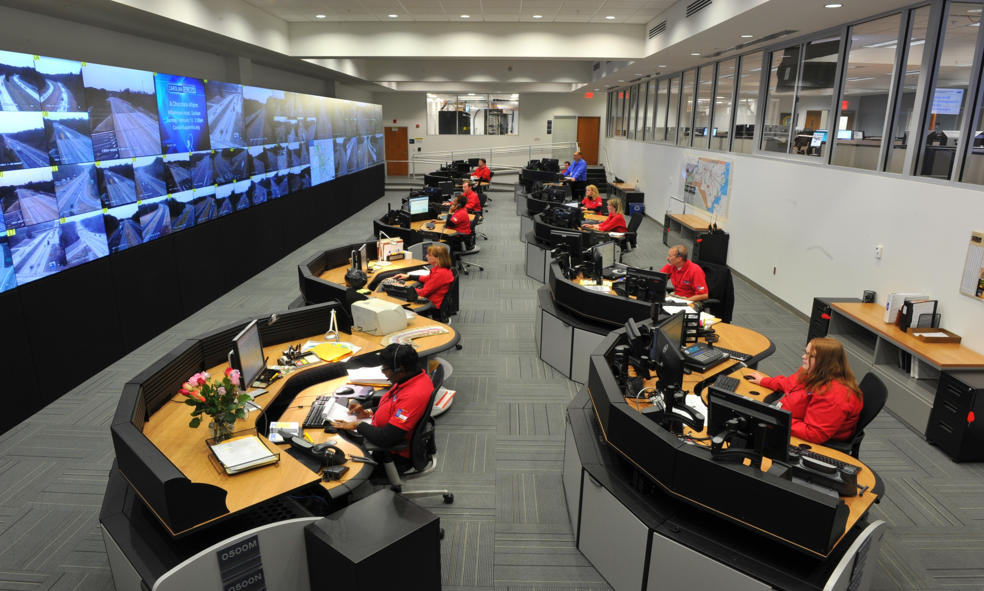
Transportation Management Centers (TMCs)
Lesson 3
Notes:
Transportation Management Centers, or TMCs, are also called Traffic Operations Centers, or TOCs
Photo shows control room of NCDOT’s Statewide Transportation Operations Center (STOC)
STOC operates 24x7x365 and can be reached by law enforcement & other responders by calling 877-627-7862
NCDOT also operates a TMC in Charlotte known as the Metrolina TMC
Municipal or county-operated TMCs are also available in areas across NC
Call your communications center to help relay info to & from NCDOT or local DOTs
TMCs may be operated at the local, regional, or state level
TMCs serve as the hub for the collection and dissemination of incident information and they play a critical role with incident detection and verification
TMCs are typically responsible for:
Monitoring traffic conditions using:
Closed-circuit television (CCTV)cameras
Roadway detectors and congestion maps
Public safety contacts via phone and/or computer-aided dispatch (CAD) links
Providing real-time traveler information using:
511 – phone systems, websites and Twitter
Dynamic message signs (DMS)
Portable changeable message signs (PCMS)
Highway advisory radio (HAR)
Providing traffic and incident information notification to other traffic management/ communication centers, public safety partners and the news media
Monitoring traffic management devices to ensure they are functioning properly
Controlling traffic management devices, including ramp meters, traffic signal systems, etc.

Slide 26
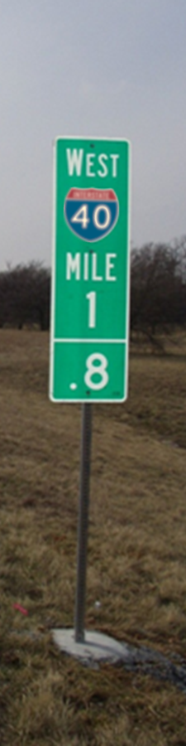
Determining the Incident Location
Lesson 3
Telecommunicators should:
  Ask the calling party to identify the specific geographic location of the incident, referencing highway mile markers, nearest exit/entrance ramp signs, etc.
  If applicable, advise motorists of the Driver Removal Law and instruct them to move vehicles off the roadway if there are no injuries
Once verified, responders are dispatched to respond
Notes:
With the proliferation of cellphones, it is often a passing motorist who first notifies a communications center, via 911, that an incident has occurred
Streets and nearest intersections are the staple for identifying traffic incident locations
Highway markers and nearest interchange locations are most often used for freeway locations
Some places use ½ mile while other systems use mile markers every one-tenth of a mile
Interchange locations present unique challenges – some places have implemented lettering for ramps and flyovers with mile marker type signs indicating the ramp letter
Motorists may have traveled past the incident by the time they talk to the communications center, so it is not uncommon for them to give a location that is downstream of the actual incident
Knowing the color of the vehicles involved can help responders verify whether they have located the reported incident or a different incident
Multiple reports in the same area should be assessed for any additional information that can help improve response
A simple TIM strategy at the onset of a call is to direct motorists to remove vehicles from travel lanes if the vehicles are drivable
Once verification is complete, the communications center will dispatch the appropriate response

Slide 27
Initial/Windshield Size-Up
Lesson 3
Upon first arriving on-scene, an initial or windshield size-up report should be provided
  Confirmation of geographical location
  Preliminary analysis of current situation
  Actions required to mitigate the situation
  Resources required to support those actions
Should take into consideration any unique safety situations apparent to responders as they arrive on-scene
Notes:
Reiterate that the more accurate and detailed the information obtained and relayed to additional responders, the faster the response and the quicker the clearance
Upon first arriving on-scene, an immediate arrival report should be given to the communications center:
Confirm the geographical location and approach specifics for later-arriving units
Other pertinent information that can be determined at first glance
Actions and additional resources that may be required
This report, typically given while still in the vehicle and viewing the scene through the windshield, is called a windshield size-up
A more detailed and accurate size-up should be provided after the responder has more fully assessed the scene
Emphasize that if the incident location is different than what was originally reported, it MUST be reported to the communications center
Additional responding units can report to the correct location
If an emergency were to occur (i.e., struck-by, shooting, officer down, etc.), additional responders would know where to go

Slide 28
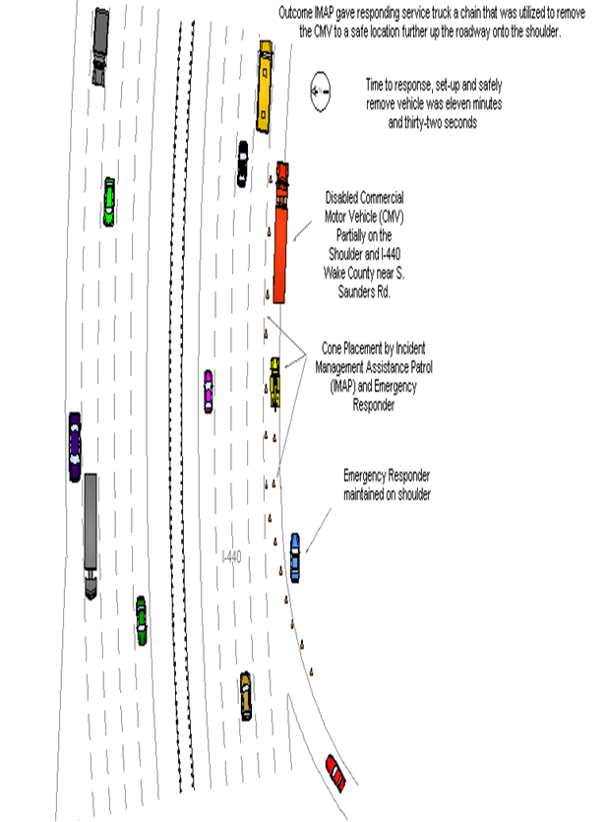
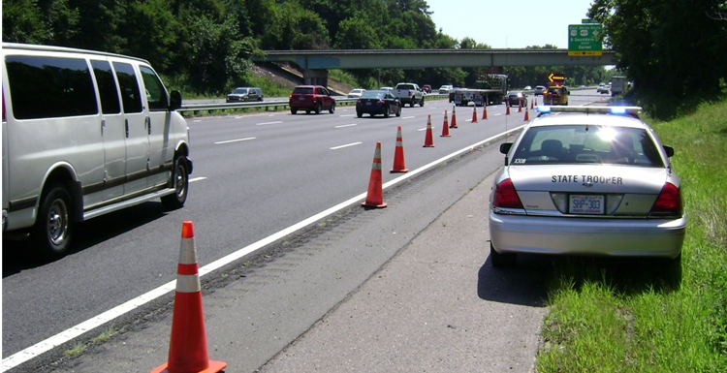
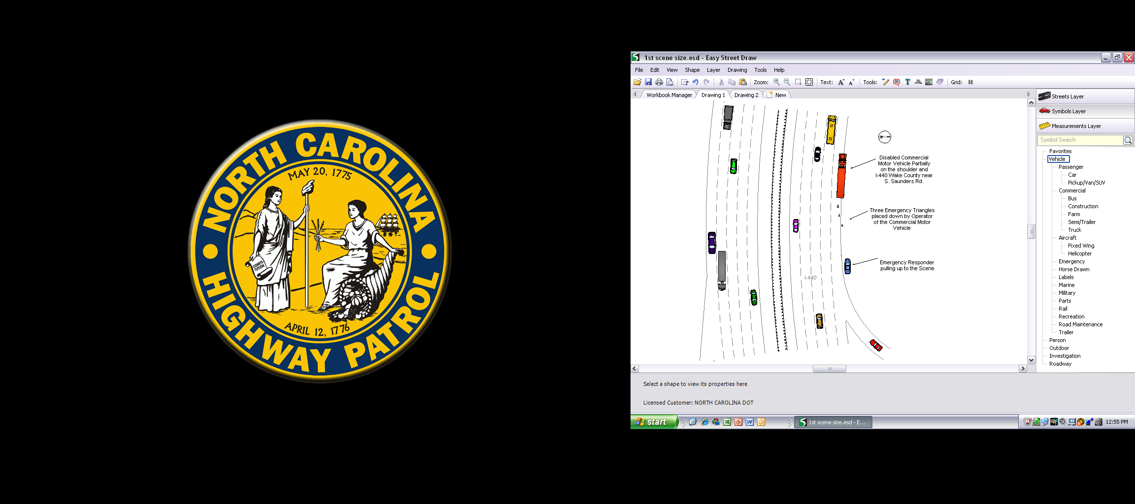
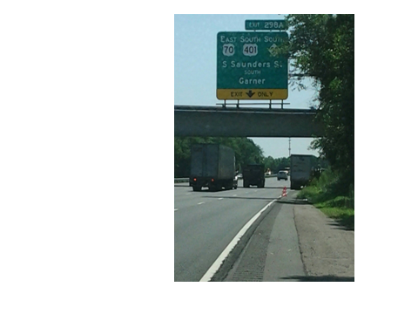
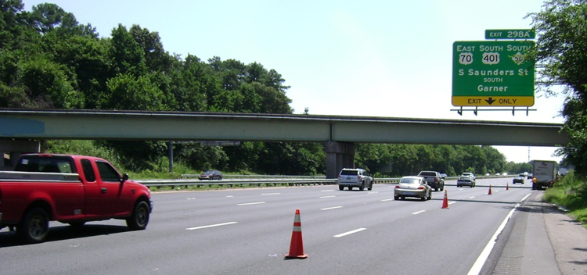
What Is Your Windshield Size-Up Report?
Lesson 3
Notes:
Elements of this arrival size-up report should include the following:
Unit identification
Exact location of incident
Number and type of vehicles involved
Degree of damage
Number of lanes closed
Hazards or problems
Establishment of command
Sample Answer: July 30, 2014 in Raleigh, NC, a Commercial Motor Vehicle (CMV) broke down on I-440 (outer belt line) partially on the shoulder and the roadway between Lake Wheeler Rd. and South Saunders Rd. Emergency Responder pulls up onto the shoulder of the roadway to assess the scene, and take appropriate action. What would you do?
Action Plan: Emergency Responder immediately notified Incident Management Assistance Patrol (IMAP) unit. Emergency Responder initially began to put out flares and positioned his Patrol Vehicle in a safe location due to the curvature of the roadway. Upon arrival of the IMAP unit, the Emergency Responder and IMAP Personnel began placing cones to notify the oncoming traffic of an incident ahead. Eventually, a work truck arrived to assist the CMV unit and a chain was supplied by the IMAP unit to tow the CMV unit to a safe location in a straight section of I-440 on the shoulder of the roadway to expedite clearing time . This joint effort alleviated other incidents from occurring and never stopped the flow of traffic. TIM’s works if you know how to implement the training. This only took eleven minutes and thirty-two seconds.

Slide 29
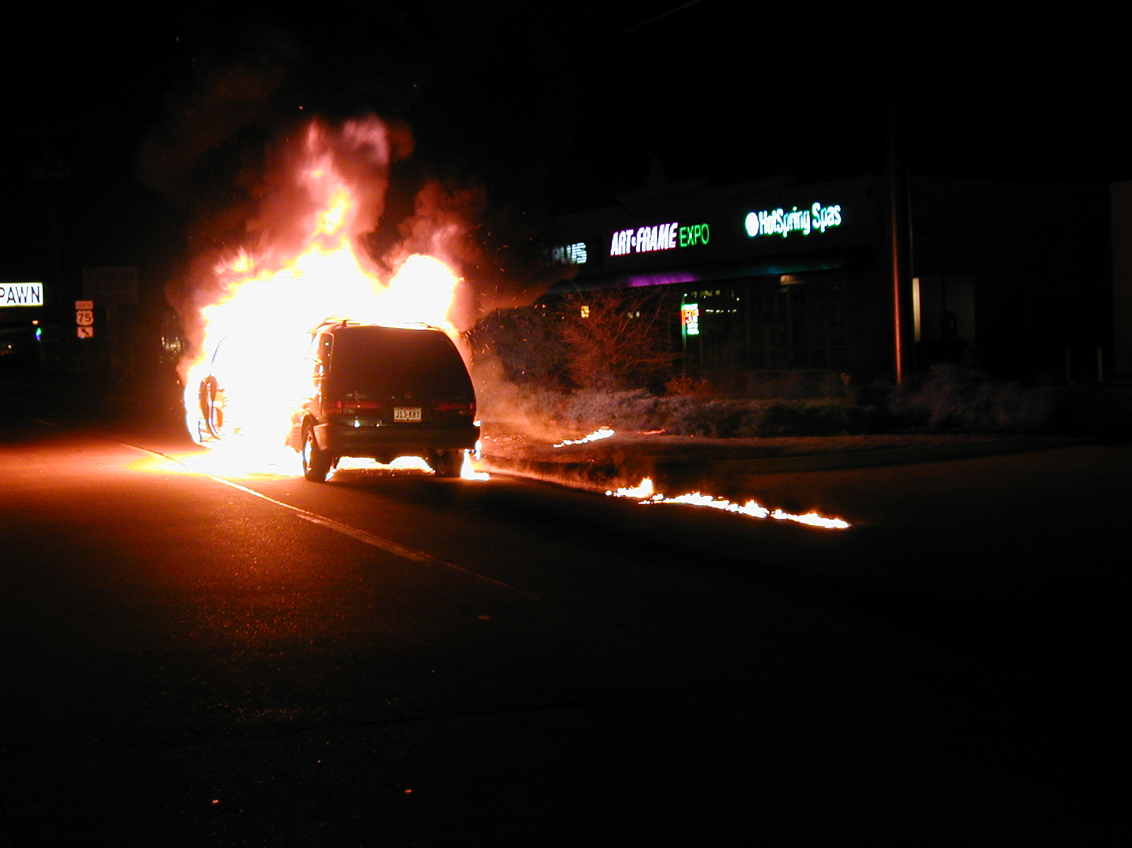
Initial/Windshield Size-Up
Lesson 3
Typical F/R Windshield Size-Up Report:
“Unit one on-scene… Main Street… Minivan fully engulfed in flames in the right lane… The vehicle is leaking fuel… Assuming Main Street command ”
Notes:
This example is an initial arrival report for a fire department when arriving on a scene

Slide 30
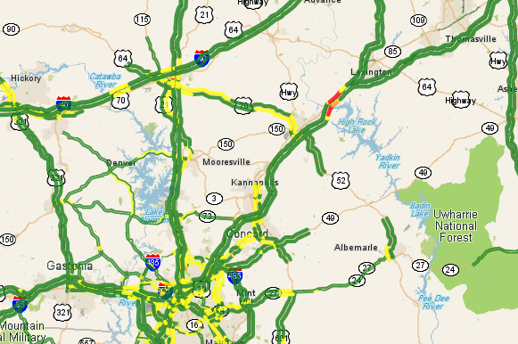
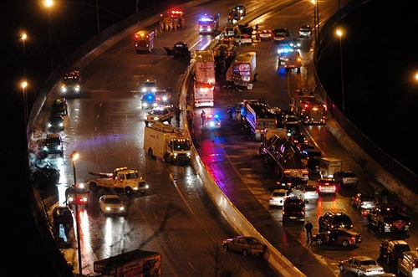
Windshield Size-Up: What NCDOT Needs to Know and Why
Lesson 3
What NCDOT can see…
Need to know:
Why?
On-scene or en route?
En route = Report… On-scene = Confirmed
Exact location?
Where to send IMAP or Maintenance. What detours/alt routes to use.
Which lanes are blocked?
What messages to place on DMS. Planning temp. traffic control. How to approach scene (IMAP).
What’s actually happening…
Type of vehicles
& injuries/fatalities (sensitive info NOT needed)
Determine incident severity, possible duration, who to send/notify, etc.
What’s involved? (e.g. tree down) and/or what’s damaged? (e.g. 30ft of guardrail)
Who to send. What equipment to bring. How quickly to respond (after incident or RIGHT NOW).
Notes:
NCDOT has many resources that can help provide information about traffic incidents
CCTV Cameras
Law Enforcement CAD Feeds
Speed Sensor Maps
IMAP Units
However, these resources have limitations
Rural areas often do not have CCTV coverage or IMAP
CAD Feeds and Speed Sensors are good indicators of an incident but say very little about what’s actually happening
Since Law Enforcement & other responders are typically first to arrive and are on-scene to provide detailed info, DOT relies on their reports to determine how to respond
Having detailed information ASAP supports rapid response
Insufficient or miscommunicated information can lead to DOT arriving late, with not enough people, and/or with the wrong equipment
Example: Farm tractor reported as a “Commercial Vehicle”
Example: Tree limb reported as “Tree Down”
Intelligent Transportation Systems (ITS)
ITS broadly refers to different devices, equipment, and other systems used to monitor traffic, detect incidents, provide information to motorists, and direct traffic flow (e.g. traffic signals)
ITS is most often concentrated in urban areas where traffic volumes & incident levels are highest
ITS may also be available in rural areas in areas where congestion or incident activity are frequently high
Some ITS devices, such as Changeable Message Signs (CMS), are portable and can be deployed by NCDOT when & where they are needed
Dynamic Message Signs (DMS) are similar to CMS in that they can display different messages to motorists depending on what message is needed BUT DMS are permanently installed
NCDOT Support for Temporary Traffic Control (TTC)
Most responders carry some TTC devices (e.g. traffic cones and flares) but often carry a very limited amount
Law enforcement & other responders should use the TTC devices that they have on-hand but should call NCDOT for additional TTC if needed
NCDOT can assist with additional TTC in a few ways;
DMS via NCDOT Traffic Management Centers (TMCs) and/or Statewide Traffic Operations Center (STOC) – TMC/STOC operators can remotely activate DMS to display messages about incidents ahead
Incident Management Assistance Patrol (IMAP) – especially in urban areas, IMAP units carry additional equipment to establish safer Traffic Incident Management Areas (TIMAs)
NCDOT Maintenance – for rural or urban areas, DOT maintenance personnel can deploy proper TTC where it is needed (especially for longer duration incidents)
Law Enforcement & other responders should get to know their local DOT personnel and become familiar with the resources that DOT can provide and their hours of operation

Slide 31
Progress Reports
Lesson 3
A detailed scene size-up should be provided within 15 minutes
Additional progress reports should be provided at regular intervals
Initial/ Windshield Size-Up Report
15-Minute Detailed
Size-Up Report
Regular
Progress Reports
Notes:
The initial arrival/windshield size-up report provides a quick assessment of the scene for dispatch and other responders monitoring the channel
A more detailed size-up report should be conducted within 15 minutes of arrival at the scene
For the duration of the incident, progress reports should be communicated at regular intervals to provide an update on how response, traffic management, and clearance activities are progressing

Slide 32
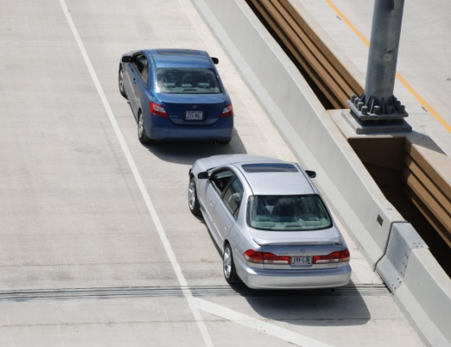
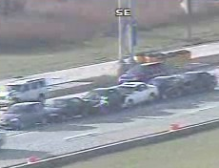
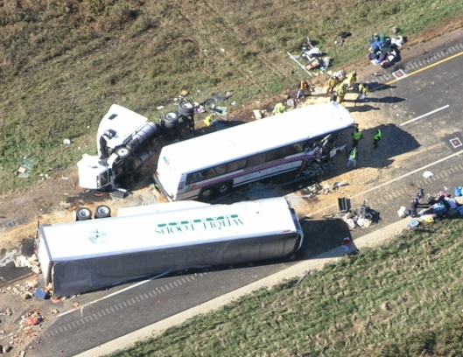
Lesson 3
Incident Duration Classifications
Minor
< 30 minutes
Intermediate
30 min - 2 hrs
Major
> 2 hours
Notes:
MUTCD Chapter 6I divides traffic incidents into three general classes based on duration
Each of these classifications have unique traffic control characteristics and needs
The longer you are on the scene, the more that is expected and the more that is required of you and your TIM team
MUTCD Chapter 6I states that responders arriving at a traffic incident should:
Estimate the magnitude of the traffic incident
Estimate the expected time duration of the traffic incident
Estimate the expected vehicle queue length
Set up the appropriate temporary traffic controls based on these duration estimates; shorter requires less resources; long duration incidents will require more resources
Lesson 7 provides a detailed overview of traffic management and temporary traffic control
If the expected duration is bordering between two classifications, it is recommended that the higher (longer) classification be used to ensure that adequate resources are requested and mobilized

Slide 33
TIM Timeline
Lesson 3
Notes:
Animation: Click forward to make dark orange box appear, second click brings up detailed view of Notification, third click makes orange box appear, and fourth click brings up detailed view of Arrival
Ask/Discuss: How can notification and verification impact the TIM Timeline? [First and second click]
It is very important to obtain and provide accurate and concise incident details
Locations reported by citizen callers are not always accurate and can delay response
This lesson also covered portions of Arrival [Third click]
Ask/Discuss: How can the scene size-up impact the TIM Timeline? [Fourth click]
An accurate windshield size-up report can help to ensure later arriving units have the correct location and are aware of any safety concerns

